Slide 1
Welcome to Nursery
Respect: Endurance: Friendship
We shall be playing games together, reading stories, helping you and keeping you safe.

Slide 2
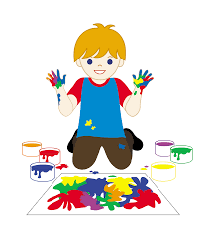
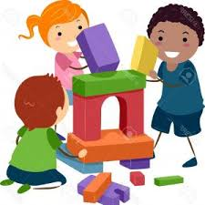
We come to school to learn. At school, we learn all sorts of skills to help us to be happy,
successful life-long learners.

Slide 3
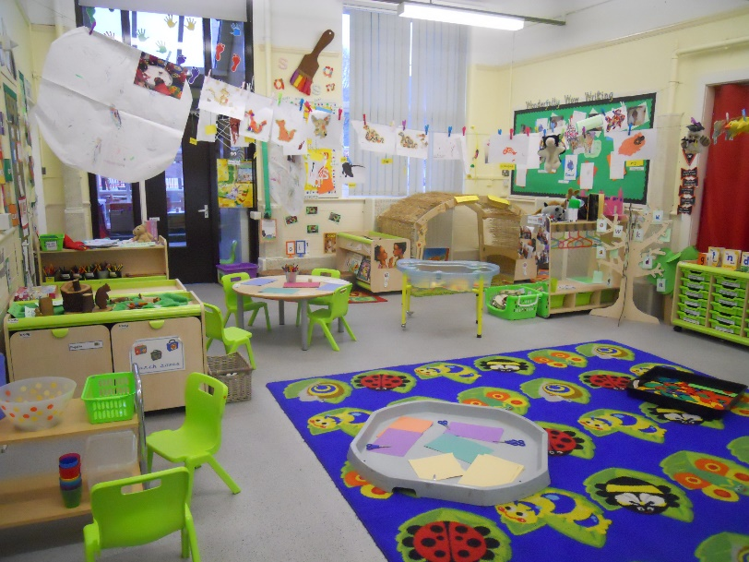
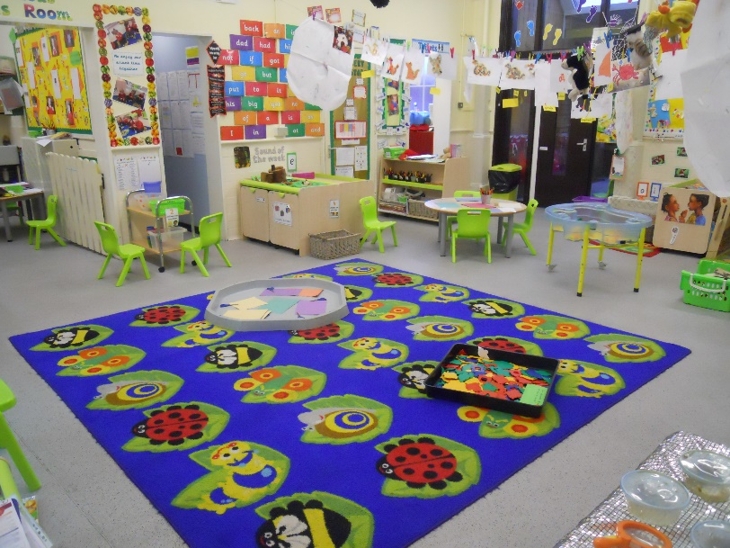
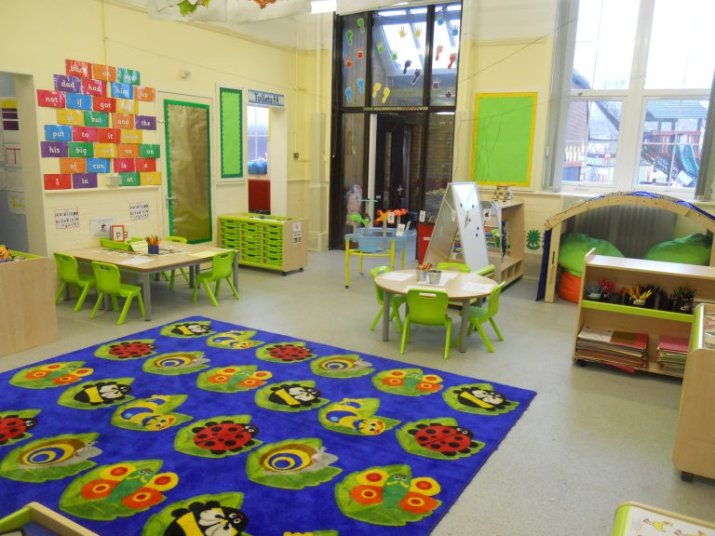
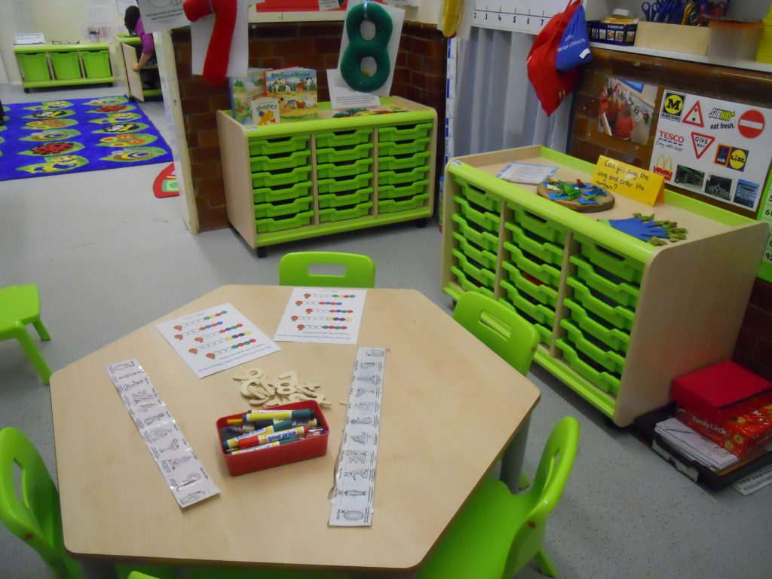
Our classroom
Nursery children have their own classroom.

Slide 4
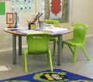
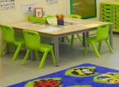
Working with adults
Adults at school talk to you about your learning. They watch you play and learn. Adults ask you about your learning then plan what skills you need to learn next.
Adults invite you to learn with them, all sorts of things to explore!

Slide 5
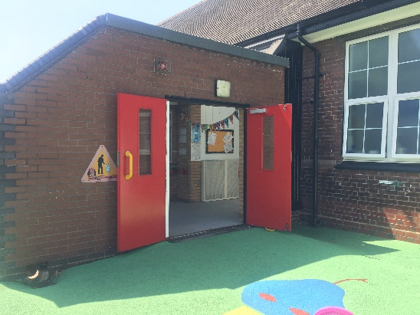
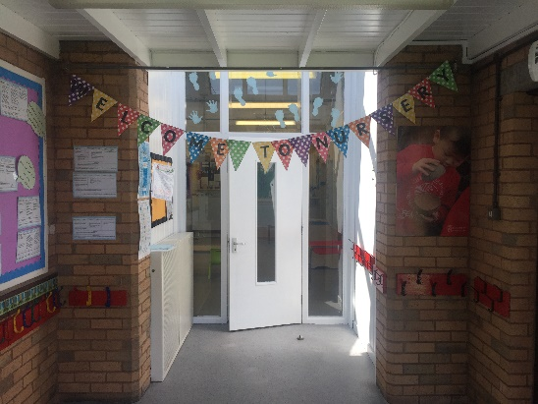
This is the entrance to your cloakroom.
This is the cloakroom. Everyone has a peg with their name on. Your coat goes on your peg.

Slide 6
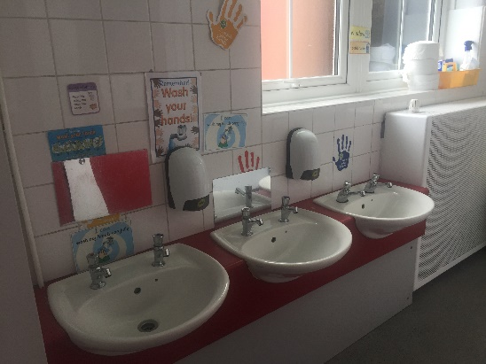
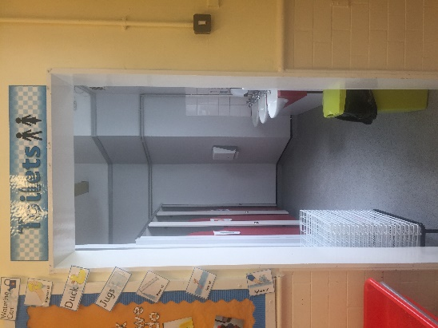
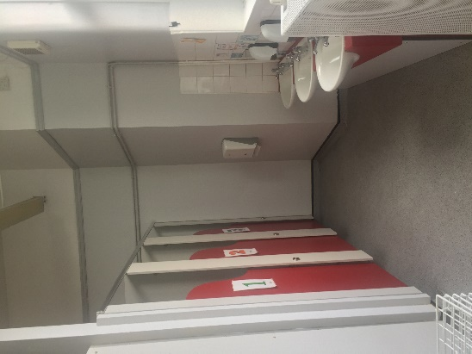
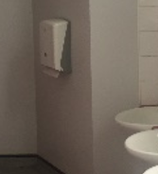
Our toilets
We have three toilets, just for nursery children. They are exactly the right size for you!
This is where you wash your hands using soap and water. Then you can dry your hands.

Slide 7
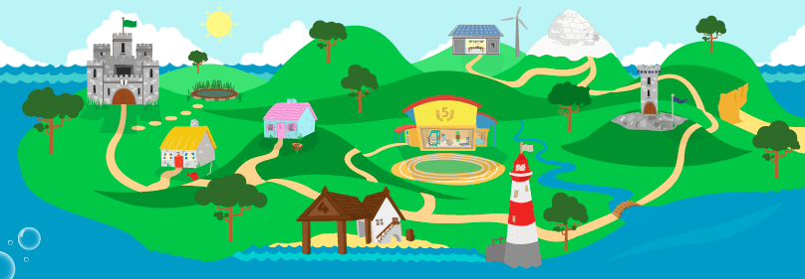
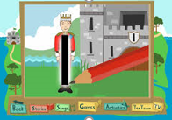
Ten Town TV Island
Every day you will learn about numbers or shapes.
We use Ten Town TV on our Interactive Whiteboard to help you to recognise and to write your numerals.
Each number in Ten Town has its own character. King 1 is one of the characters.

Slide 8
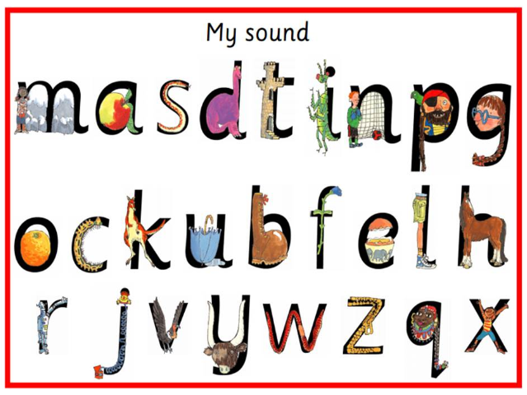
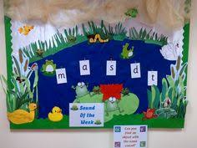
You will also have phonics each day. We use Read, Write, Inc to help you.
This is Fred Frog. He will help you to learn to read and write.

Slide 9
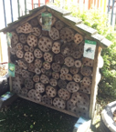
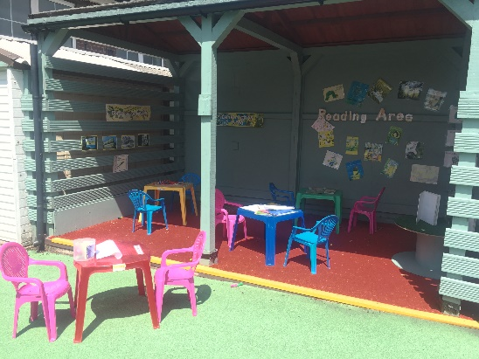
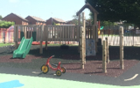
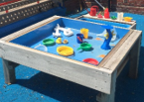
Here is your playground.
The bug hotel.
The reading area.
The climbing equipment
The water tray.

Slide 10
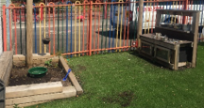
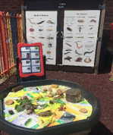
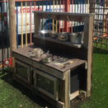
More playground activities!
The mud kitchen.
The sand area.
The minibeasts investigations area.

Slide 11
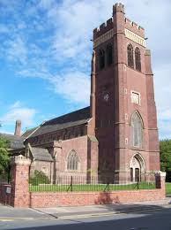
Church School
We have strong links with Christ Church in Fenton, where we are welcomed as part of its local community.
We are a church school. We sing hymns, say prayers and learn about God and Jesus.

Slide 12
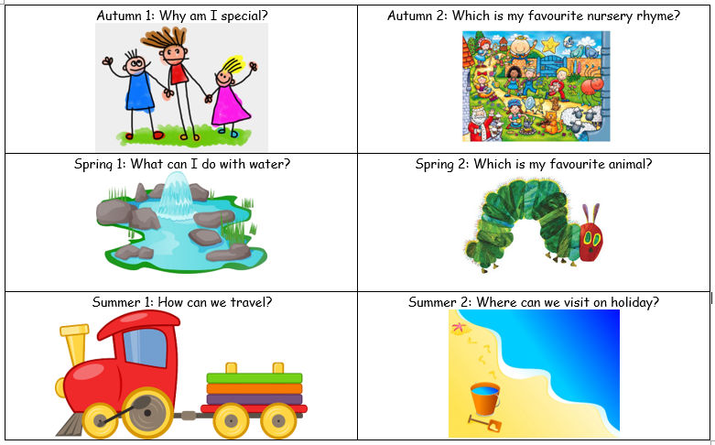
Things you will be learning about.

Slide 14
Take care and stay safe.
See you soon!!

